Slide 1


A Slice of
Raspberry Pi
Stephen Mouring
www.sequoiainc.com
@sequoiainc

Slide 2

Speaker
Work:

Slide 3
Speaker
Work For:

Slide 4

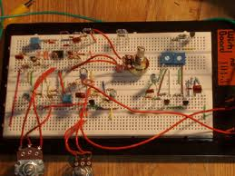
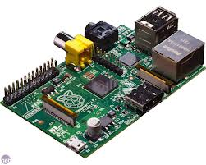
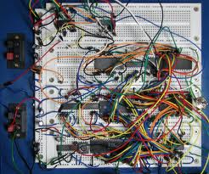
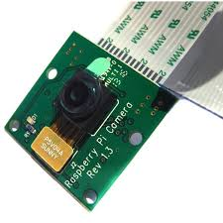
Speaker
Play with:

Slide 5
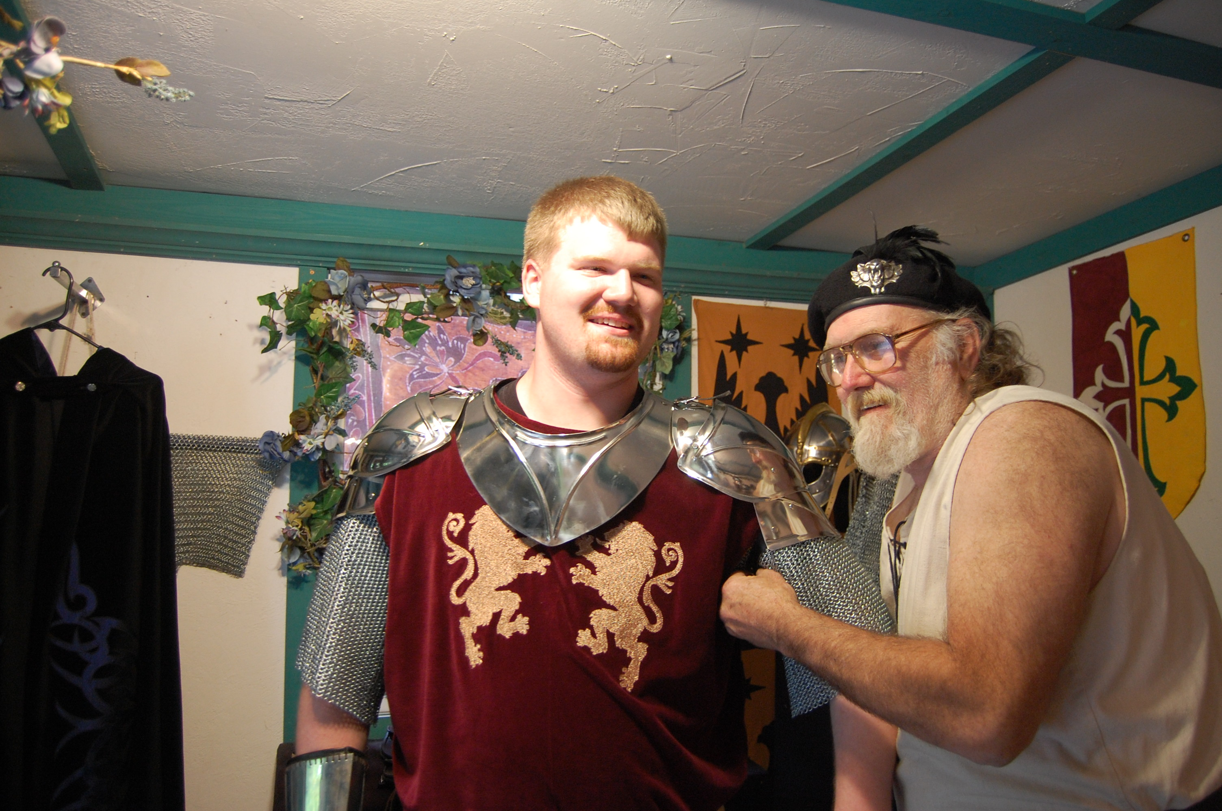
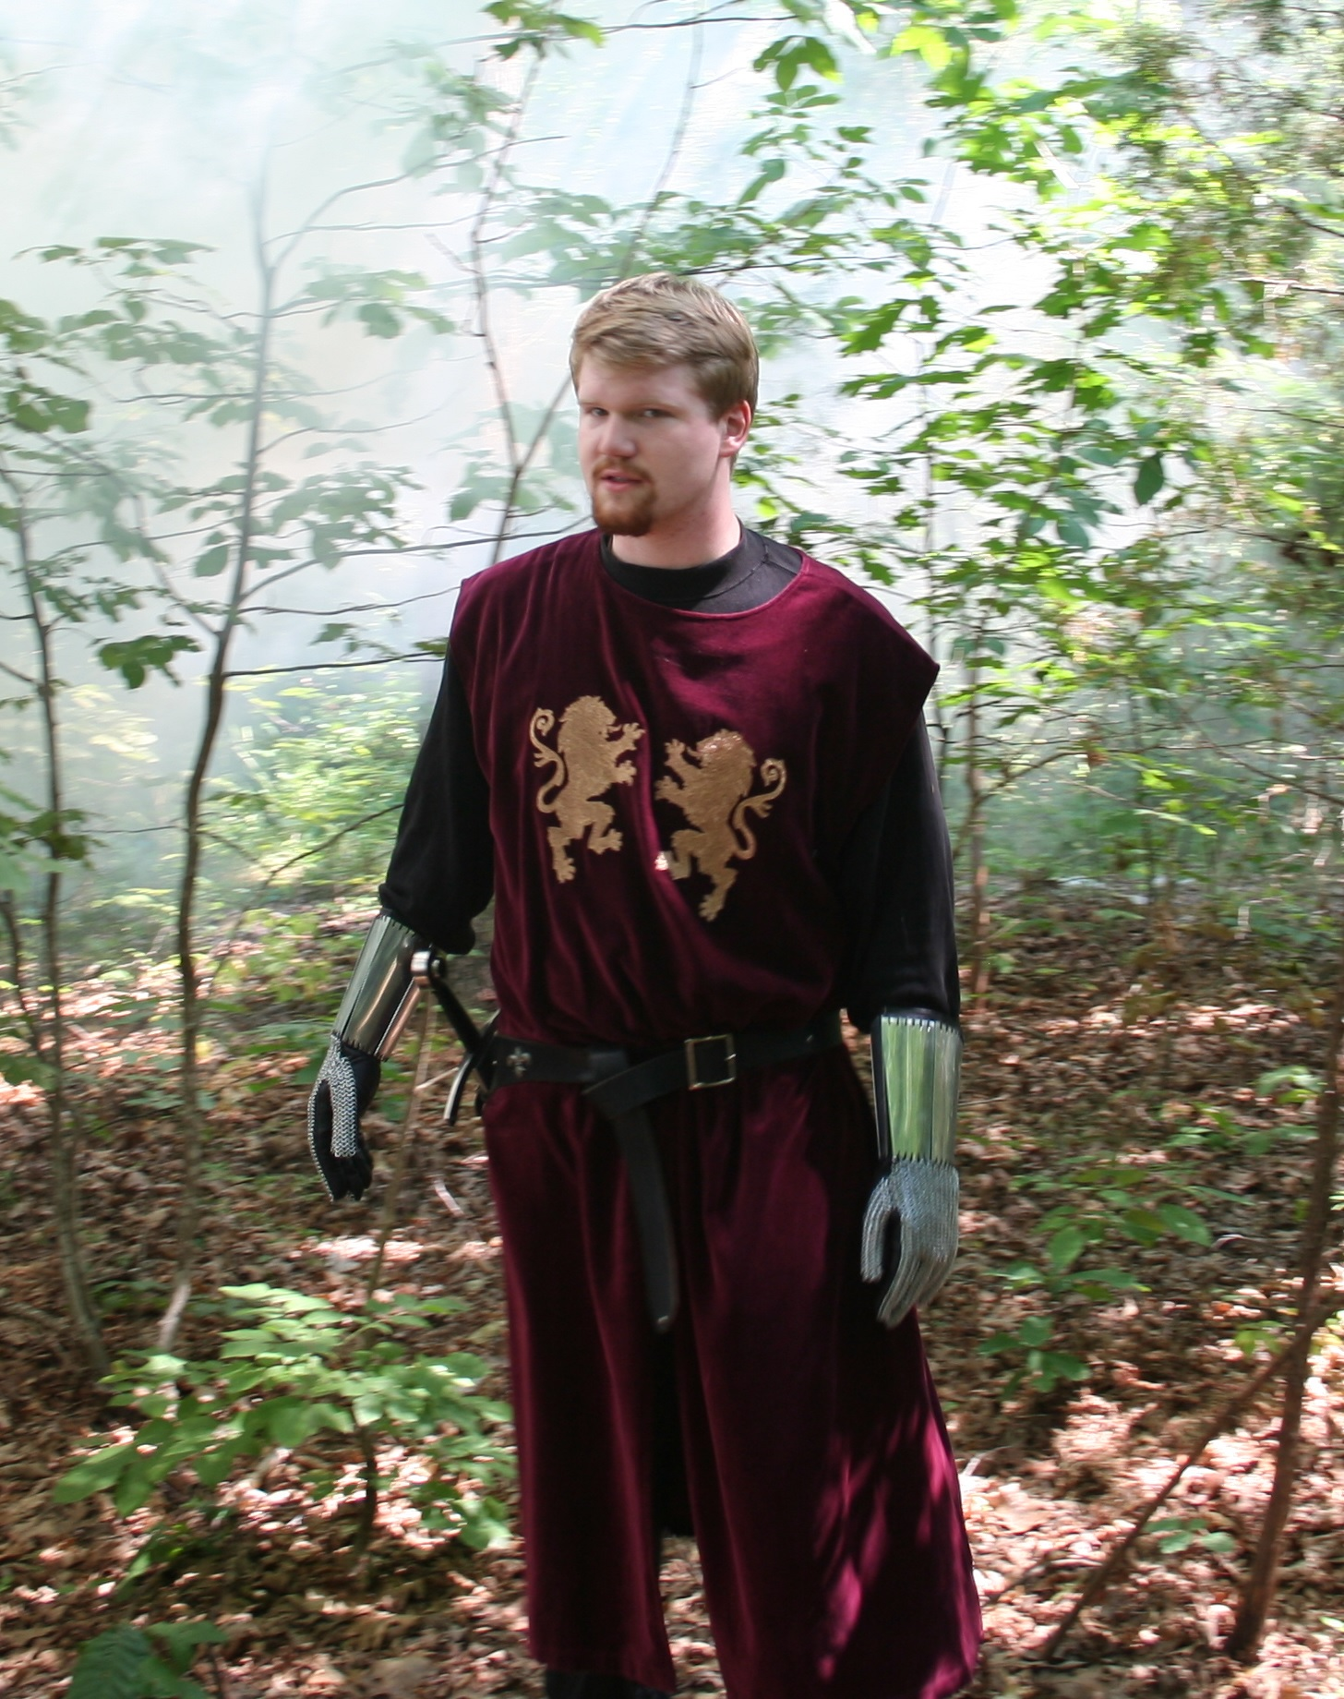
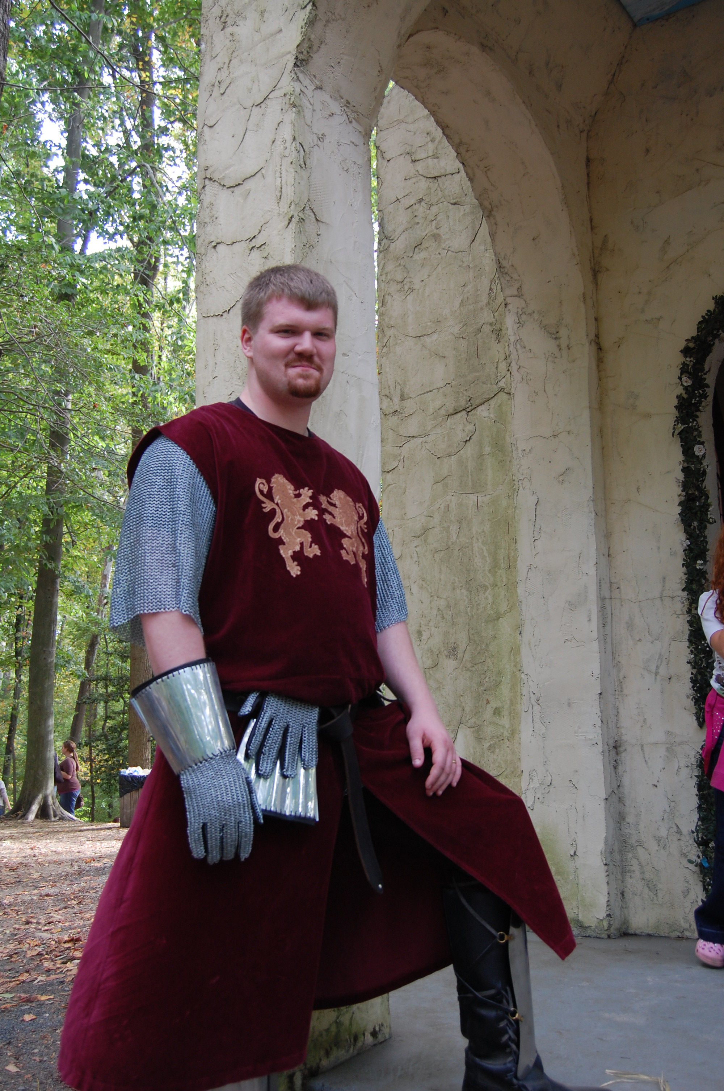
Speaker
Play with:

Slide 6
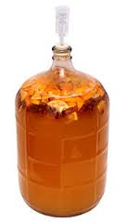
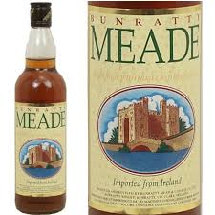

Speaker
Drink and make:

Slide 7
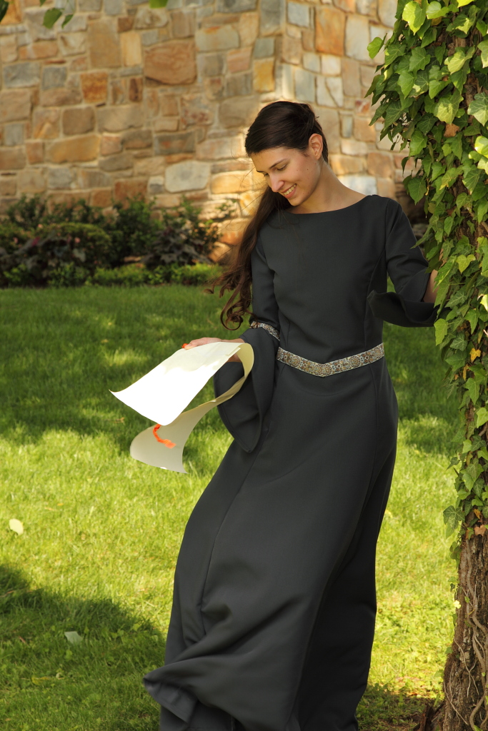
Speaker
Married to:

Slide 8
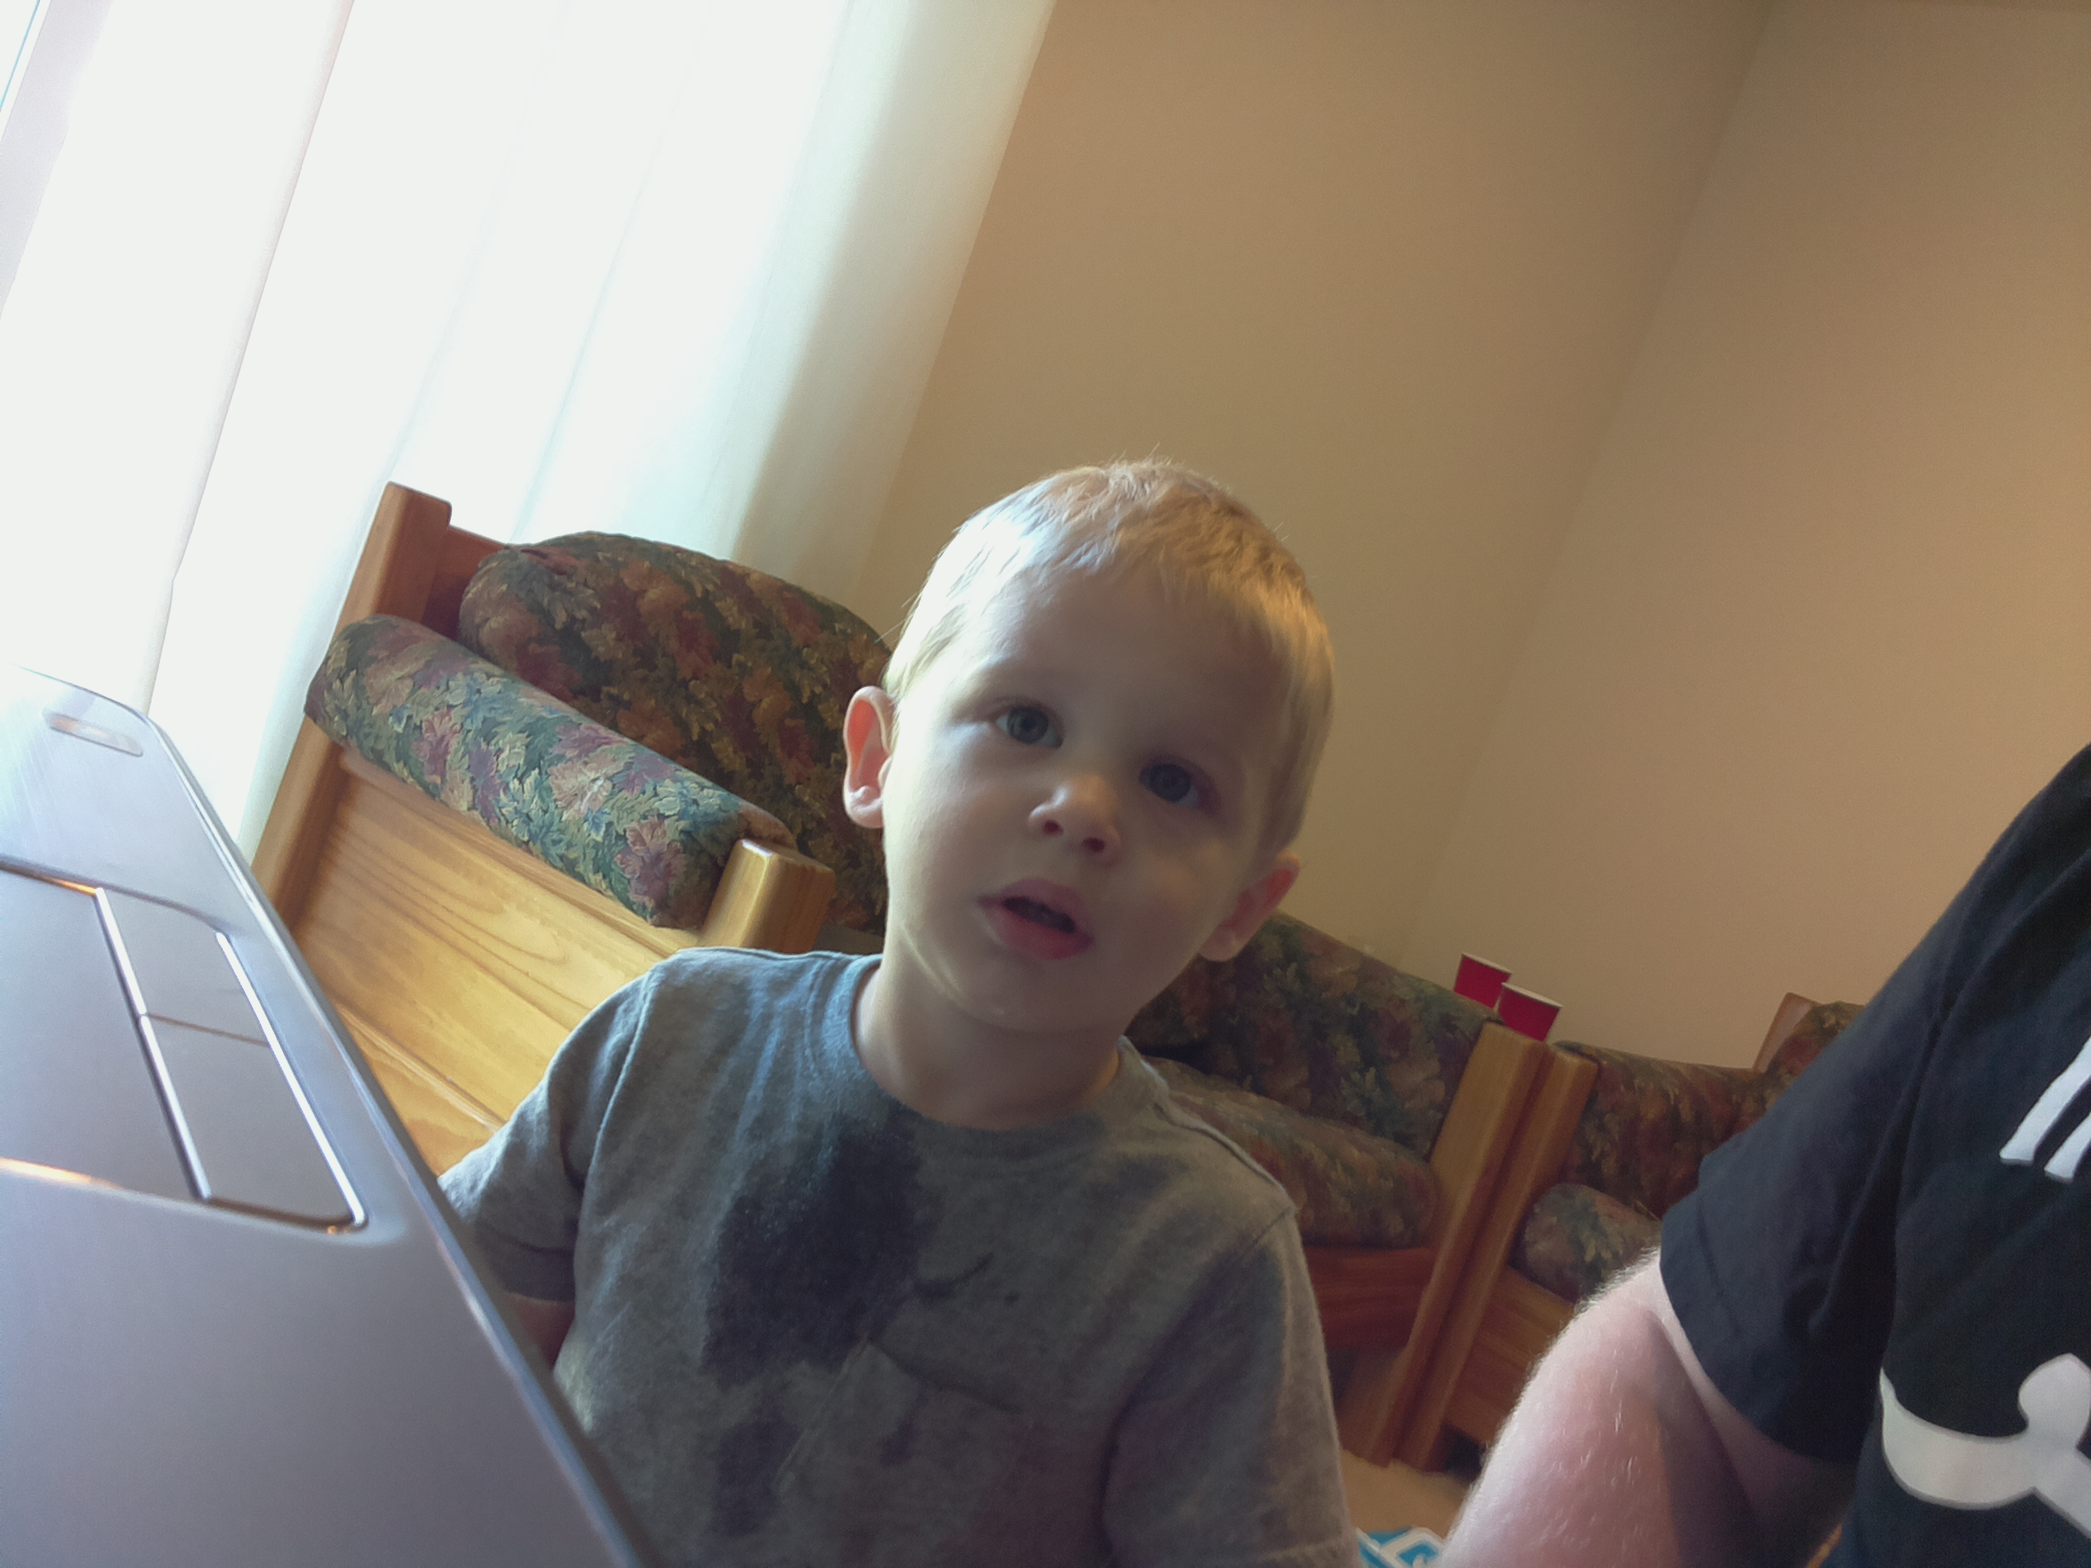
Speaker
We have a:

Slide 9
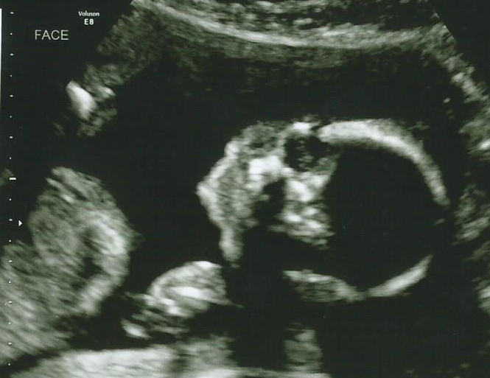
Speaker
And also:

